Slide 1
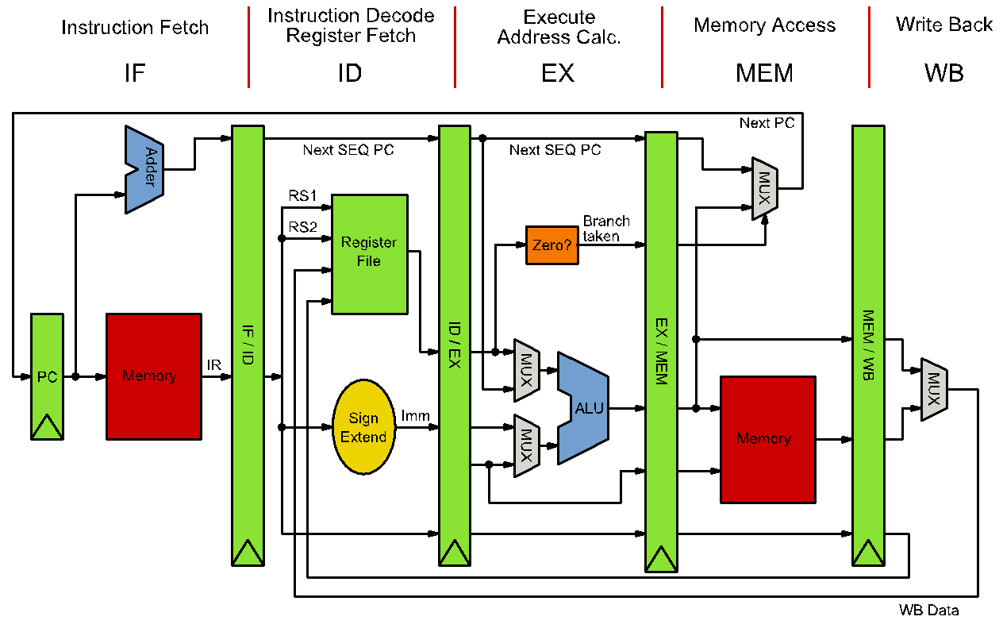
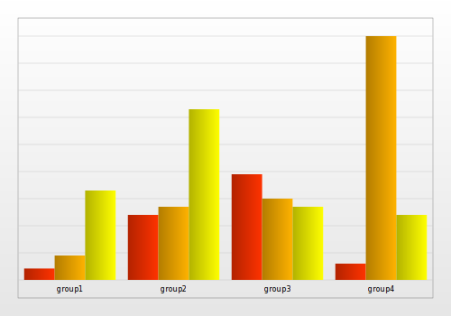


Preparing Your Poster for the 6th IEEE CASS
Rio Grande do Sul Workshop
José Rodrigo Azambuja
Introduction
Suggested font sizes
Posters should be prepared over an A4 page (21 x 29.7 cm) PDF and printed out in A0 (84.1 x 118.9 cm) format;
Stick to the template in the following areas: main title, author list, affiliation and contact sections;
The remaining can be freely modified to suit your needs.
Element | A4 Font size | A0 resulting Font size
Main Title | 24 | 96
Section Title | 16 | 64
Section Text | 14 | 56
Author list | 14 | 56
Affiliation | 9 | 36
Sources | 6 | 24
Suggested Structure
Introduction
Method
Results
Conclusions
Source: Wikipedia
Tips
Source: Google
Go straight to the point;
Be simple and clear in your statements;
Prefer images to text;
Credit your sources;
Remember you’ll be there to provide further explanations.
Universidade Federal do Rio Grande do Sul
Programa de Pós-Graduação em Engenharia Elétrica
Av. Osvaldo Aranha, 103 – 90035-190 Porto Alegre/RS, Brazil
Contact: jrfazambuja@inf.ufrgs.br

